Slide 1
(Martin Luther King Middle)

Slide 2
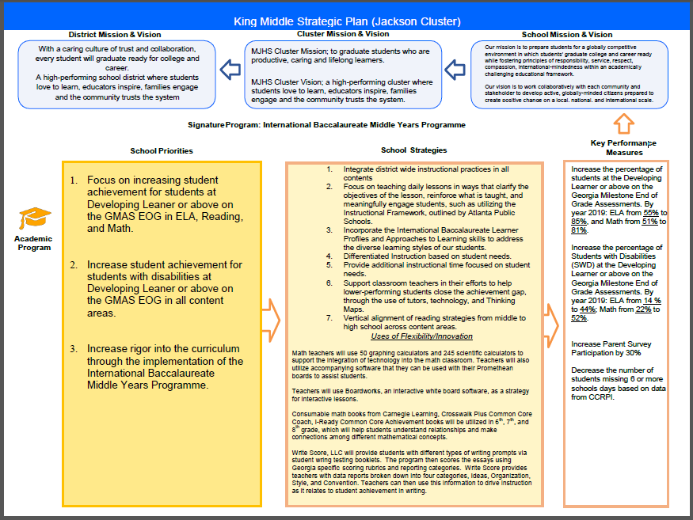
King Middle FY18 Strategic Plan
(Insert Copy of Strategic Plan Here)

Slide 3
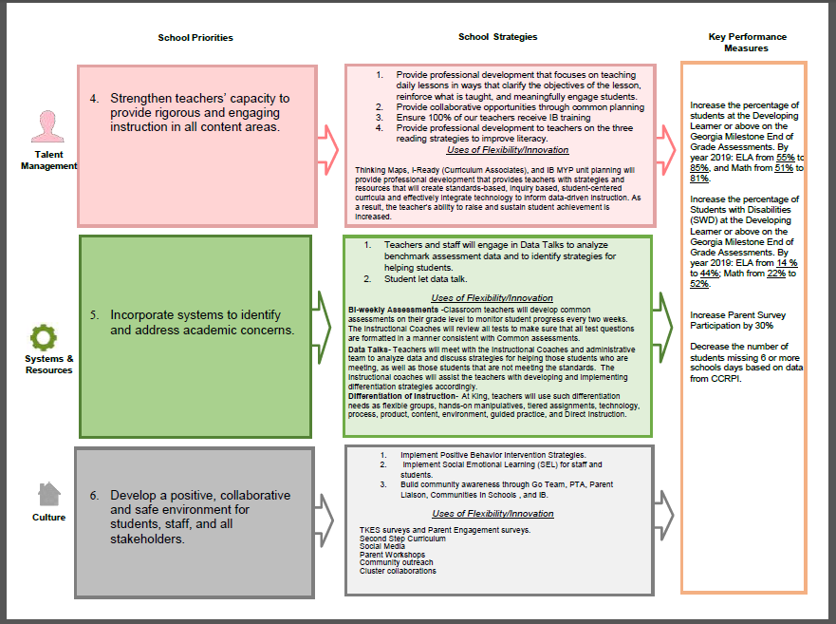
King Middle FY18 Strategic Plan
(Insert Copy of Strategic Plan Here)

Slide 4
FY18 Funding Rationale
FY’ 18 Funded School Priority | Rationale
Additional paraprofessionals (instructionally) | Assist with instructions
Professional training for paraprofessional | Professional training in content for paraprofessionals.
Additional teacher (possibly per LC) | dual certified in Math and Reading in 6th and 7th grade.
Accelerated math path (possibly reading/ELA accelerated) | Address tier 3 students. Prepare students for advance high school classes.
Professional development for content teachers | Professional development for content teachers in working with students with disabilities.

Slide 5
Description of Strategy Categories
Priorities – FY18 funding priorities from the school’s 3-5 year strategic plan.
Strategies – Lays out specific objectives for schools improvement
Request – “The Ask”. What needs to be funded in order to support the strategy?
Funding Source – What source of funds will finance the request (i.e. general, cluster, signature, Title I)

Slide 6
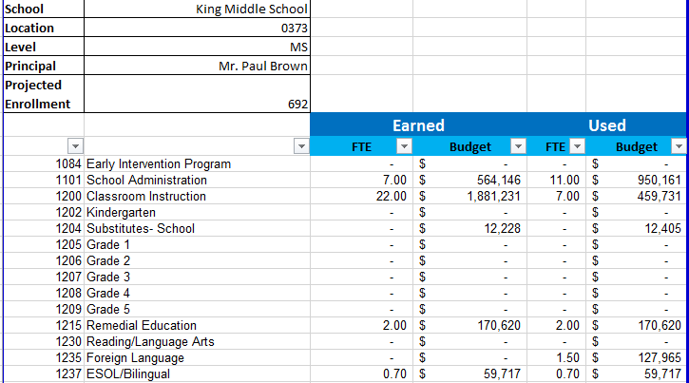
Budget Summary

Slide 7
Budget Summary

Slide 8
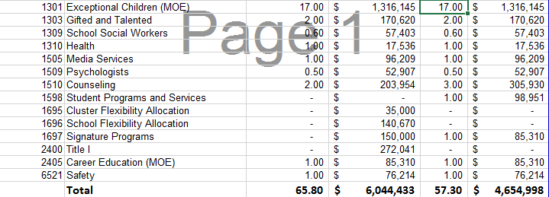
Budget Summary

Slide 9
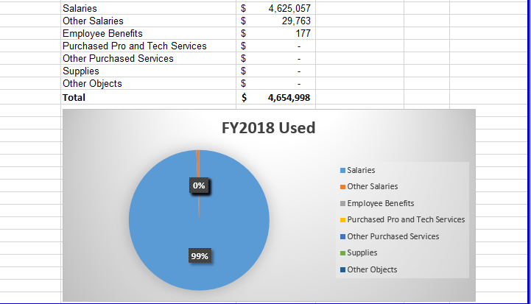
Budget Summary

Slide 10
Budget Summary
Step 2 Principal Drafts
FY 18 Budget
Jan. 9-13
(Firm)
Step 4 Submit budget to Associate Supt. For Review
Jan. 23-27
(Firm)
Step 1 Approved Strategic Plan
By Dec. 16 (Firm)
Step 5 GO Team Final Budget Approval Meeting
Jan. 30-Feb. 3 (Suggested)
Step 3 GO Team Feedback Session
Jan. 16-20
(Suggested)
Step 6
HR Staffing Conferences Begin
Feb. 6
(Firm)

Slide 11
Focus Area Descriptors
Strategic Plan Categories | District Descriptions of Categories
Academic Program | Our students will be well-rounded individuals who possess the necessary academic skills and knowledge and are excited about learning.
Talent Management | We will retain an energized and inspired team of employees who are capable of advancing ever-increasing levels of achievement for students of all backgrounds.
Systems & Resources | We will improve efficiency (productivity, cost, etc.) while also making decisions (including resource allocations) that are grounded in a strategic academic direction and data.
Culture | We will build trust with the community, and we will have engaged stakeholders (employees, students, parents, community members, partners, etc.) who are invested in the mission and vision and who support the creation of student-centered learning communities.

Slide 12
FY18 Strategic Plan Break-out
Priorities | Focus Area | Strategies | Requests | Funding Sources | Amount
Increase level of rigor and relevance (example- please remove) | Academics (example- please remove) | Implementation of guided reading (Writers Workshop training for all staff) (example- please remove) | Purchase an additional Teacher (example- please remove) | General Funds (example- please remove) | $84, 134 (example- please remove)
Additional paraprofessionals (instructionally) | Talent Management | Assist with instructions
Professional training for paraprofessional | Talent Management | Professional training in content for paraprofessionals.
Additional teacher (possibly per LC) | Talent Management | dual certified in Math and Reading in 6th and 7th grade.
Accelerated math path (possibly reading/ELA accelerated) | Academic Program | Address tier 3 students. Prepare students for advance high school classes.
Professional development for content teachers | Talent Management | Professional development for content teachers in working with students with disabilities.

